Slide 1
Protocols
Mr Butler

Slide 2

The Specification
Topic
Explain the need for communication protocols
Describe the Open Systems Interconnection (OSI) network organisation model and each of its component layers
Describe communication protocols: Transmission Control Protocol/Internet Protocol (TCP/IP); Ethernet; Carrier Sense Multiple Access with Collision Detection (CSMA/CD); token passing; Wi-Fi; Bluetooth; voice over internet protocol (VoIP); and radio-frequency identification (RFID)

Slide 3
Explain the need for communication protocol
A communication protocol is a set of rules or procedures that enable devices on computer networks using different technologies (or from different manufacturers) to communicate.
Communication protocols are formal descriptions of digital message formats and rules. They are required to exchange messages in or between computing systems and are required in telecommunications. Communications protocols cover authentication, error detection and correction, and signalling.

Slide 4
Explain the need for communication protocol
Communications protocols are implemented in hardware and software. There are many communications protocols that are used everywhere in analogue and digital communications. Computer networks cannot exist without them.
You need protocols in computer networks because computer networks consist of devices and software made by many different vendors.
The only way to ensure compatibility among them all is to have protocol specifications that describe the mechanics and formats of all the data exchanged over the network.
A network protocol defines rules and conventions for communication between network devices.
  Network protocols include mechanisms for devices to identify and make connections with each other, as well as formatting rules that specify how data is packaged into messages sent and received.

Slide 5
Describe the Open Systems Interconnection (OSI) network organisation model and each of its component layers
The Open Systems Interconnection Model (OSI) provides a framework for data to be transferred between networked computers.
  The model works even if different data formats or different types of networks are communicating.
The core of this standard is the OSI Reference Model, a set of seven layers that define the different stages that data must go through to travel from one device to another over a network.
The OSI model was developed by the International Standards Organisation (ISO) as guidelines for developing standards.
  If a manufacturer’s products obey these standards it will mean ease of connection to another manufacturer.

Slide 6
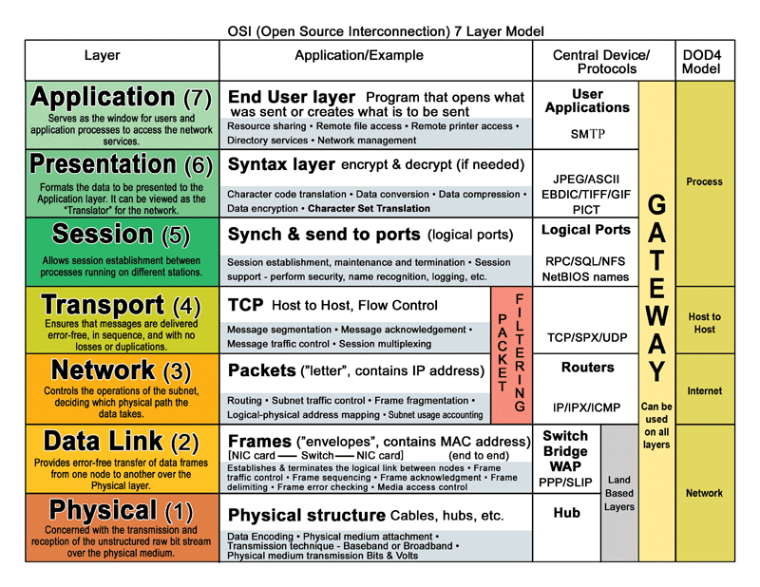

Slide 7
Benefits of the OSI Model
Any hardware that meets the OSI standard will be able to communicate with any other hardware that also meets the standard;
  the same applies to software that meets the OSI standard – again, it will be able to communicate with any other hardware or software that also meets the standard.
Consumers are given a wider choice since hardware/software from any manufacturer will work together and as OSI is independent of country, it doesn't matter where the hardware/software is made.
OSI is not dependent on the operating system used and the protocols for OSI are defined at each stage.
Other benefits include error handling in each layer and the different layers can operate automatically.

Slide 8
Basic Rules in the OSI Model
Notice that the top three layers have been grouped together and are called the ‘Application Set’ and the bottom four layers are called the ‘Transport set’.
The ‘Application Set’ is mainly concerned with controlling how the various applications currently running are making use of the network (i.e. MS Word - File Server and Chrome - Internet).
The ‘Transport Set’ is only concerned with passing information through the network – it does not care where the information comes from (Word or Chrome, for example)
Each layer can only ‘talk’ to the one above it and below it e.g. The ‘Network’ layer can only pass information to the ‘Transport’ layer above it and the ‘Data Link’ layer below it.
Passing information from one layer to another is done in a standard way. This means that if company ‘A’ has written some software for the ‘Transport’ layer – and company ‘B’ has written some software for the ‘Network’ layer – then they are guaranteed to be able talk to each other.
Application | Application Set
Presentation
Session
Transport | Transport Set
Network
Data
Physical

Slide 9
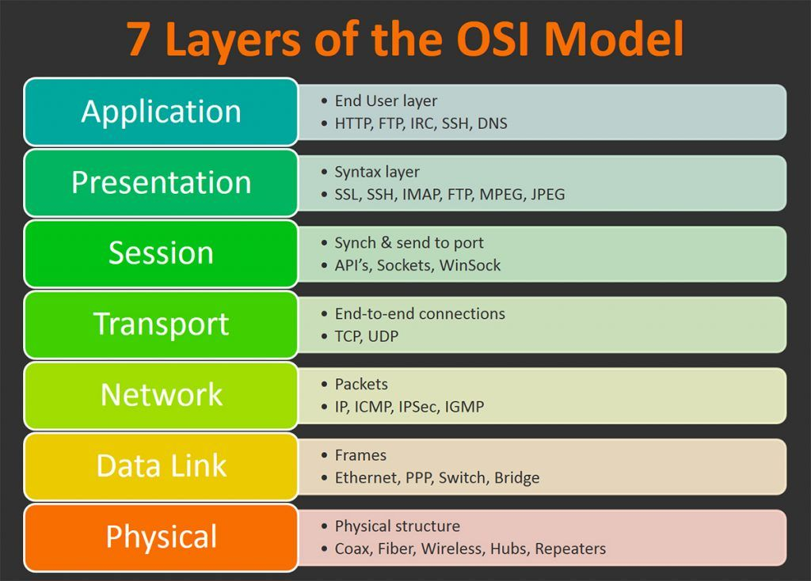
Application Layer
The application layer is only concerned with presenting information in human friendly way (for example, Outlook).
The OSI model is relevant to all kinds of devices, that use inbuilt computer processors, including mobile phones, iPods etc. The Application Layer receives its information from the ‘Presentation’ layer just below it.

Slide 10
Presentation Layer
This layer shares information with the Application layer above it and the Session layer beneath it.
Used for:
Converting information
This layer is not concerned with ‘presenting’ information to a person, but rather ‘presenting’ information to the various electronic devices in the correct format. For example, it will send video information in the right format to the VDU or the correct audio information to the sound card.
Data Encryption
Another useful task for this layer is to implement encryption. For example, say the Application layer is running a shopping application and you have just pressed the Buy’ button. The job of the Presentation layer is to scramble the credit card number you have supplied so that only the store itself can read the number.
Note that the Presentation layer on the shop computer will be responsible for ‘unscrambling’ the data back into the correct credit card number (decryption). The presentation layer will encrypt \ decrypt information if required.
Data Compression
The presentation layer may compress \ decompress information.

Slide 11
Session Layer
In the world of networking, a session begins when an application wants to make a connection to a remote server (WAN).
The session layer opens a temporary ‘channel’ between the two to allow for communication. You can have more than one session running at the same time.
Interacts with the presentation layer above and transport layer below.

Slide 12
Transport Layer
The transport layer shares information with the Session layer above it and the Network layer beneath it
It will divide the information into convenient sized packets – these packets will then be sent on different routes to their destination.
The packets may arrive in a different order to which they were sent. The packets are then reassembled at the destination point into the order in which they were sent. Organising packets.
This layer can also check for errors.

Slide 13
Network Layer
The Network layer shares information with the Transport layer above it and the Data Link layer beneath it
The Network layer is the “traffic policeman” of the OSI model as it works out the best route for the packets to use.
Every packet that the Transport layer has created needs to be sent to the correct machine across the network.
Every computer has a unique address (IP address) allowing the network layer to add the correct address to each packet. It also reads the addresses of incoming packets to a computer and if they are destined for that computer then it allows them through.
Packets not addressed are blocked (principle of network ‘firewall’).

Slide 14
Data Link Layer
The Data Link layer shares information with the Network layer above it and the Physical layer beneath it.
Data is broken down by the higher layers into ‘packets’. Each packet needs to be broken up into the most basic form of data i.e. data ‘bits’. A ‘bit’ has two values – a ‘high’ or a ‘low’. (high is a 1 bit and a low is a 0 bit). Each packet is converted into a series of bits. This is the job of the data link layer.
It converts the outgoing packets into the correct series of bits. It also converts incoming bits back into complete packets.
Bits can be corrupted as they travel along the network i.e. a bit can be flipped into the wrong state so a ‘high’ bit may become a ‘low’ bit and vice versa. The data link layer will attempt to spot these reversals and fix them.

Slide 15
Physical Layer
The Physical layer shares information with the Data Link layer above it.
Bits and bytes have to be converted into a physical effect so that they can be transmitted.
  There are various methods of transmitting information - for example a pulse of light can be used to represent a data bit, fibre optic cables are then used to provide a path in the network.
  A radio signal can be used, indeed, ‘Wi-Fi’ networks have become abundant. Electrical signals can be used, which are carried along copper wires. There are millions of Ethernet networks using this method.
It is the job of the Physical layer to convert the abstract ‘data bit’ inside the computer into a physical effect of some kind.

Slide 16
Activity: Summarise the OSI Model
APPLICATION…
PRESENTATION…
SESSION…
TRANSPORT…
NETWORK…
DATA LINK…
PHYSICAL…

Slide 17
Describe communication protocols: Transmission Control Protocol/Internet Protocol (TCP/IP); Ethernet; Carrier Sense Multiple Access with Collision Detection (CSMA/CD); token passing; Wi-Fi; Bluetooth; voice over internet protocol (VoIP); and radio-frequency identification (RFID)
TCP/IP
Short for Transmission Control Protocol/Internet Protocol, TCP/IP is a set of rules (protocols) governing communications among all computers on the Internet. More specifically, TCP/IP dictates how information should be packaged (turned into bundles of information called packets), sent, and received, as well as how to get to its destination.
What is the TCP layer?
The TCP layer supports the transfer of files between computer systems and controls security/permission issues. It can handle file transfer between different computers (different character sets, end of line conventions, etc.). The TCP layer also splits data into packets and allocates an address to each packet.
What is the IP layer?
The IP layer is responsible for transferring packets of data from node to node, by forwarding each packet using its address. It is responsible for verifying the correct delivery of data and detects errors or lost data.

Slide 18
Describe communication protocols: Transmission Control Protocol/Internet Protocol (TCP/IP); Ethernet; Carrier Sense Multiple Access with Collision Detection (CSMA/CD); token passing; Wi-Fi; Bluetooth; voice over internet protocol (VoIP); and radio-frequency identification (RFID)
Ethernet
Ethernet is a fast, robust solution in networking. It is a hard-wired network and is the 802.3 standard (IEEE). Ethernet defines not only the networking protocol but also the physical plugs and sockets used.
Hardware must physically work together, but so does the way data is handled between the networked computers - Ethernet not only defines hardware, it also defines how data is to be handled. Therefore, Ethernet is a standard that defines network hardware and also how data is to be handled (network protocol).
Ethernet deals with the Physical and Transport layers of the OSI 7 Layer Model. The Physical layer deals with hardware and the Transport layer of the model deals with the handling of data across a network.
Systems communicating over Ethernet divide a stream of data into shorter pieces called frames. Each frame contains source and destination addresses, and error-checking data so that damaged frames can be detected and discarded; most often, higher-layer protocols trigger retransmission of lost frames. As per the OSI model, Ethernet provides services up to and including the data link layer.

Slide 19
Describe communication protocols: Transmission Control Protocol/Internet Protocol (TCP/IP); Ethernet; Carrier Sense Multiple Access with Collision Detection (CSMA/CD); token passing; Wi-Fi; Bluetooth; voice over internet protocol (VoIP); and radio-frequency identification (RFID)
CSMA/CD
CSMA/CD is short for Carrier Sense Multiple Access / Collision Detection, and is a set of rules determining how network devices respond when two devices attempt to use a data channel simultaneously (called a collision).
Standard Ethernet networks use CSMA/CD to physically monitor the traffic on the line at participating stations. If no transmission is taking place at the time, the particular station can transmit.
If two stations attempt to transmit simultaneously, this causes a collision, which is detected by all participating stations; after a random time interval, the stations that collided attempt to transmit again. If another collision occurs, the time intervals from which the random waiting time is selected are increased step by step.

Slide 20
Describe communication protocols: Transmission Control Protocol/Internet Protocol (TCP/IP); Ethernet; Carrier Sense Multiple Access with Collision Detection (CSMA/CD); token passing; Wi-Fi; Bluetooth; voice over internet protocol (VoIP); and radio-frequency identification (RFID)
Token Passing
Token passing uses a token, or series of bits, to grant a device permission to transmit over the network.
Whichever device has the token can put data into the network. When its transmission is complete, the device passes the token along to the next device in the topology.
System rules in the protocol specifications mandate how long a device may keep the token, how long it can transmit for and how to generate a new token if there isn't one circulating.

Slide 21
Describe communication protocols: Transmission Control Protocol/Internet Protocol (TCP/IP); Ethernet; Carrier Sense Multiple Access with Collision Detection (CSMA/CD); token passing; Wi-Fi; Bluetooth; voice over internet protocol (VoIP); and radio-frequency identification (RFID)
WiFi
Wi-Fi (Wireless Fidelity) is a digital communications protocol, through which devices can communicate with each other without using any cabling. The IEEE committee for 802 standards which manages networking protocols among electronic devices, formed an extension 802.11 which would work on the wireless mode.
For Wi-Fi to work a small device known as a wireless transmitter is required; this device receives information from the internet via your home broadband connection. This transmitter (often referred to as a Wireless Access Point) then converts this information into radio waves and emits it, effectively creating a small, local area around itself, within which your devices can receive these radio signals if they are fitted with the correct kind of wireless adapter.
This area is often termed a Wireless Local Area Network, or WLAN for short. The radio signals are not very strong, which is why the Wi-Fi signal does not travel very far; it will travel far enough to cover throughout the average home and to the street directly outside, for example, but not much further.

Slide 22
Describe communication protocols: Transmission Control Protocol/Internet Protocol (TCP/IP); Ethernet; Carrier Sense Multiple Access with Collision Detection (CSMA/CD); token passing; Wi-Fi; Bluetooth; voice over internet protocol (VoIP); and radio-frequency identification (RFID)
WiFi
When you send information back to the internet – by clicking on a link or sending an email, for example – the process works in reverse; your device sends information via a radio signal to the wireless transmitter, which converts the signal and communicates it back via the broadband connection.
For a device such as a phone or computer to be able to pick up Wi-Fi signals, it needs to have the relevant technology incorporated within it, or have a wireless adapter fitted. Many devices, such as smartphones and tablets, come ready to accept Wi-Fi signals straight out of the box, whilst others, such as some PCs, will require buying a separate wireless card or adapter, which often comes in the form of a small device which plugs into the USB port of your PC or laptop. This device is known as a broadband “dongle”.
In summary, Wi-Fi enables two or more devices to connect (wirelessly) for data sharing. A computer with a Wi-Fi network card can connect wirelessly to a wireless router over a limited distance (60m/90m). A Wi-Fi network can either be “open” (anyone can use them) or “closed” (a password is needed). An area with wireless access is called a wireless hotspot.

Slide 23
Describe communication protocols: Transmission Control Protocol/Internet Protocol (TCP/IP); Ethernet; Carrier Sense Multiple Access with Collision Detection (CSMA/CD); token passing; Wi-Fi; Bluetooth; voice over internet protocol (VoIP); and radio-frequency identification (RFID)
Bluetooth
A Bluetooth device uses radio waves instead of wires or cables to connect to a phone or computer, for example. A Bluetooth product, like a headset or watch, contains a tiny computer chip with a Bluetooth radio and software that makes it easy to connect. When two Bluetooth devices want to talk to each other, they need to pair.
Communication between Bluetooth devices happens over short-range, ad hoc networks known as piconets. A piconet is a network of devices connected using Bluetooth technology. When a network is established, one device takes the role of the ‘master’ while all the other devices act as ‘slaves’. Piconets are established dynamically and automatically as Bluetooth devices enter and leave radio proximity.
Bluetooth is defined as being a short-range radio technology (or wireless technology) aimed at simplifying communications among enabled devices. It also aims to simplify data synchronization between devices.

Slide 24
Describe communication protocols: Transmission Control Protocol/Internet Protocol (TCP/IP); Ethernet; Carrier Sense Multiple Access with Collision Detection (CSMA/CD); token passing; Wi-Fi; Bluetooth; voice over internet protocol (VoIP); and radio-frequency identification (RFID)
Bluetooth
Bluetooth products (meaning products using Bluetooth technology) must be qualified and pass interoperability testing by the Bluetooth Special Interest Group prior to release.
Once again, it was designed to connect a range of portable devices / laptops / PDAs / mobile phones and a common use of Bluetooth is to connect desktop computers and printers. To use Bluetooth, a device has to be “Bluetooth enabled” i.e. contain a Bluetooth chip and the range can be from 10m to 100m (Class 3 and 1). However, the range can be affected by obstacles, e.g. furniture, walls, etc.
As Bluetooth was originally designed for lower-speed wireless connections, technology advancements over the years have increased its performance considerably.

Slide 25
Describe communication protocols: Transmission Control Protocol/Internet Protocol (TCP/IP); Ethernet; Carrier Sense Multiple Access with Collision Detection (CSMA/CD); token passing; Wi-Fi; Bluetooth; voice over internet protocol (VoIP); and radio-frequency identification (RFID)
Voice over Internet Protocol (VoIP)
Voice over IP (VoIP) technology allows telephone calls to be made over digital computer networks including the Internet. VoIP converts analogue voice signals into digital data packets and supports real-time, two-way transmission of conversations using Internet Protocol (IP).
Essentially, VoIP is a method of using the internet to make voice telephone calls. Digitised speech is just data and can be sent over the internet as with any other data; with the widespread installation of broadband connections, it is possible for this data to be transmitted fast enough to allow two-way conversations. With appropriate software, e.g. Skype, a user can talk with any other user connected to the internet.

Slide 26
Describe communication protocols: Transmission Control Protocol/Internet Protocol (TCP/IP); Ethernet; Carrier Sense Multiple Access with Collision Detection (CSMA/CD); token passing; Wi-Fi; Bluetooth; voice over internet protocol (VoIP); and radio-frequency identification (RFID)
RFID
Radio-Frequency Identification (RFID) is the use of radio waves to read and capture information stored on a tag attached to an object. A tag can be read from up to several feet away and does not need to be within direct line-of-sight of the reader to be tracked.
The RFID tag contains data programmed into a small computer chip and this tag is activated by radio waves emitted from an RFID reader. The tag sends the data stored in its memory back to the reader.
The range can be anything from centimetres to metres. RFID can be utilised in active systems whereby the chip has its own power supply; and in passive systems whereby the chip is activated by the reader’s power.

Slide 27
Describe communication protocols: Transmission Control Protocol/Internet Protocol (TCP/IP); Ethernet; Carrier Sense Multiple Access with Collision Detection (CSMA/CD); token passing; Wi-Fi; Bluetooth; voice over internet protocol (VoIP); and radio-frequency identification (RFID)
RFID
There are many advantages regarding the use of RFID, when comparing their use in the retail industry, for example. For example, there is no line of sight requirement and RFID tags can be read from a greater distance (as opposed to the traditional laser and barcode scanner), even in harsh environments. The information stored in a barcode is fixed and cannot be changed whereas RFID tags can be dynamically updated.
Human intervention is usually required in order to scan a barcode whereas data from an RFID tag can be read without the need for someone to properly align the tag with the equipment that reads the data. Barcodes must be visible on the outside of a product’s packaging whereas RFID tags can be placed inside either the packaging or the product itself. Finally, more data can be stored in an RFID tag than on a barcode and RFID tags have both read/write capability, whereas barcodes are read-only and cannot be reused.

Slide 28
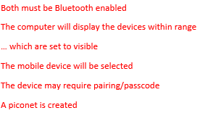
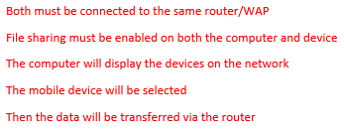
QUESTION
Q. Explain how each of the following can be used to transfer data from a computer to a mobile device.
Bluetooth
Wi-Fi
[6]

